Slide 1
Right to an Education
a child’s education is like a bird's wings, let them fly
The right to an education aims to give everyone a quality education to ensure the development of a well rounded person. In order for this human right to work there must be equal opportunities, global access, and monitored quality standards.
By: Laney Ross and Amaya Maracle
Godown 5th
February 2021

Slide 2
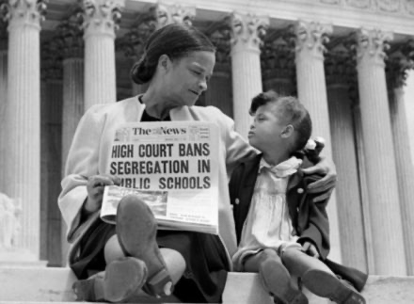
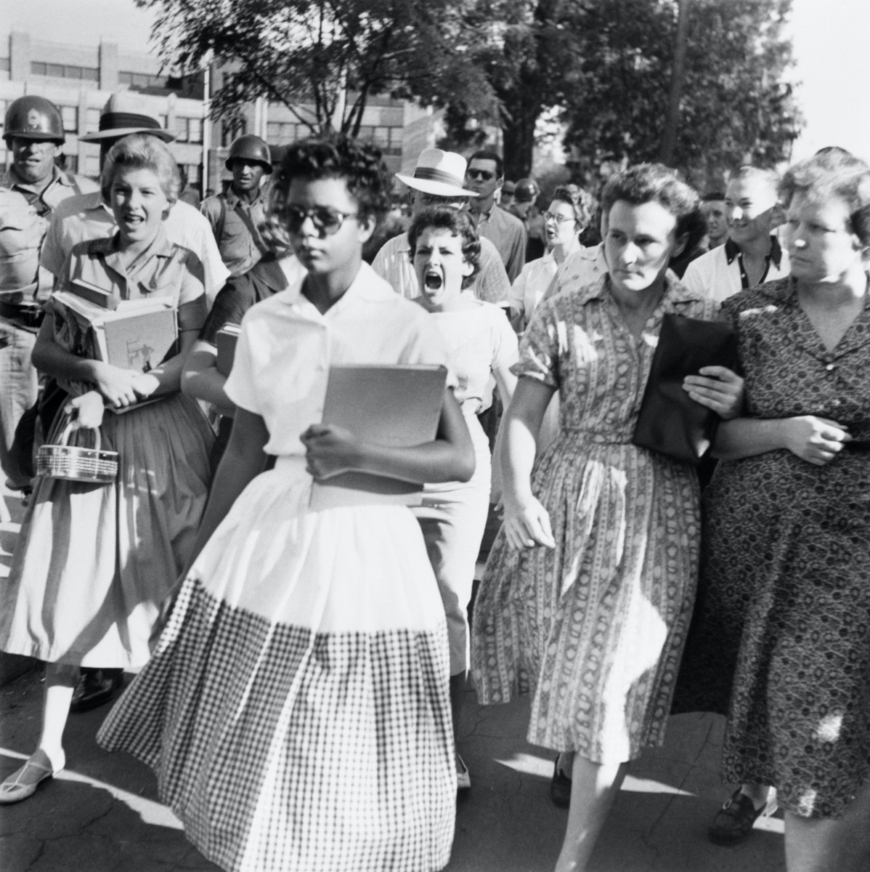
HISTORY
In 1954, the Supreme Court ruled in Brown v. Board of Education that segregation in the public schools was a violation of the Fourteenth Amendment to the Constitution
Title IV of the Civil Rights Act of 1964
prohibits discrimination in public schools
because of
race, color, religion, sex,
or
national origin
The Little Rock Nine were a group of nine black students who enrolled at formerly all-white Central High School in Little Rock, Arkansas. On September 4, 1957, the first day of classes at Central High, Governor Orval Faubus called in the Arkansas National Guard to block the black students’ entry into the high school. Later that month, President Dwight D. Eisenhower sent in federal troops to escort the Little Rock Nine into the school.

Slide 3
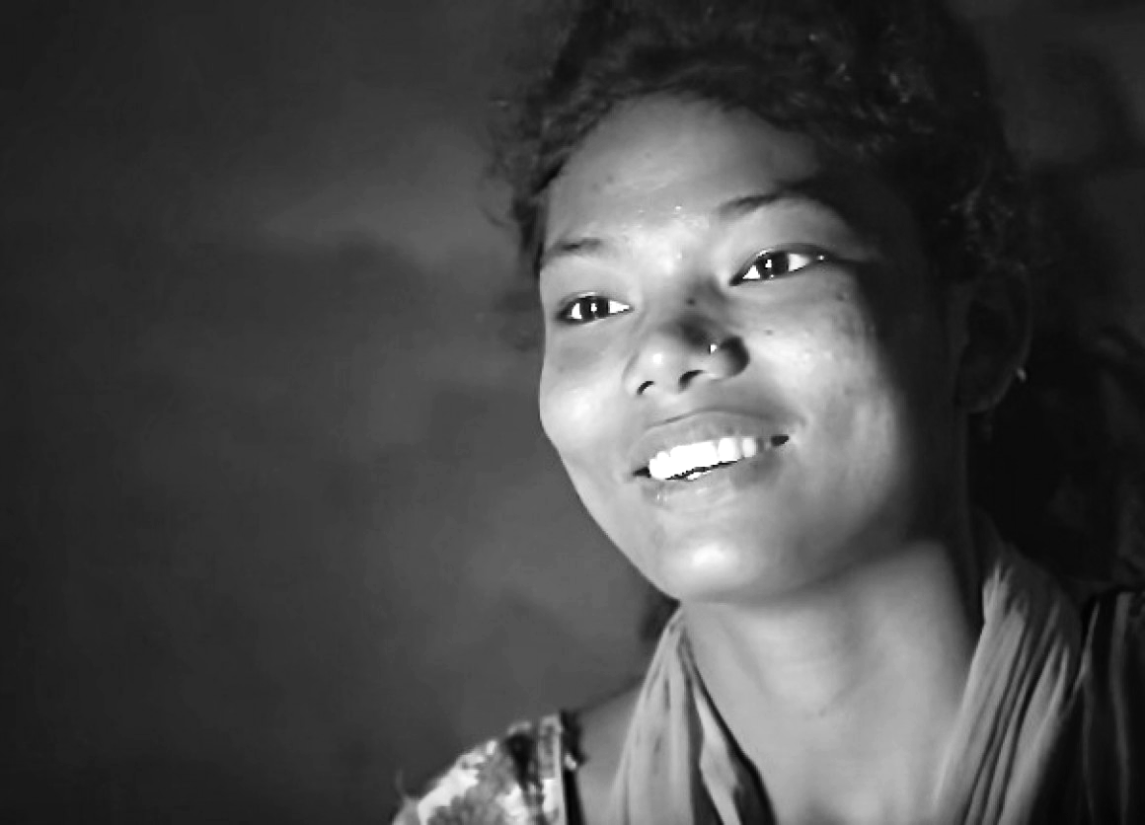
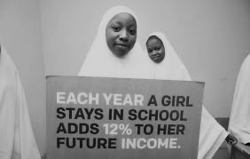
LIVE STORY
click star for video
“Even my friends say that I am transformed because of sports… and my studies have improved”
ensuring that girls can go to school helps break the cycle of poverty
An estimated 31 million girls of primary school age, and 32 million girls of lower secondary school age, were out of school in 2013
from UNICEF

Slide 4
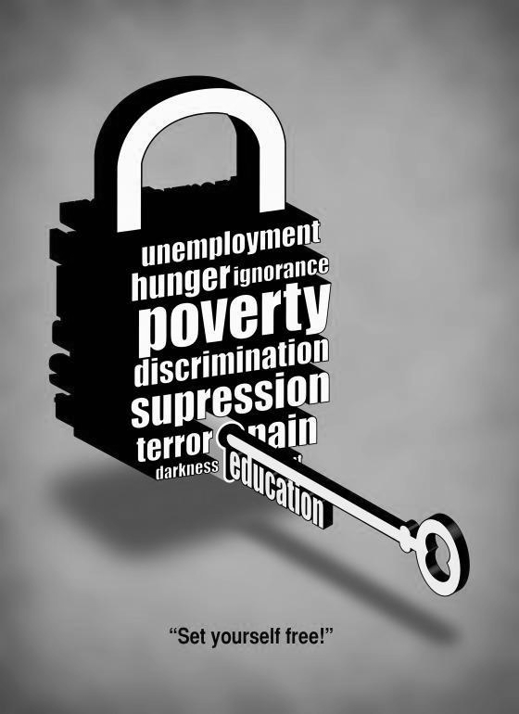
Statistics
The right to education is an important right because getting an education solves problems other than just the literacy rate. Educating children increases survival and gross domestic product. It also decreases the amount of malnourished children. It is obvious that the gross domestic product would increase if you had more educated people creating more jobs and making more money. But when women are educated they can work and make money to better provide fit their families leading to better survival and less malnourishment
A child whose mother can read is 50 percent more likely to survive past the age of 5
Over 40 years, equitable access to quality education can help a country raise its gross domestic product per capita by 23 percent
If all women had a primary education, there would be 1.7 million fewer malnourished children

Slide 5
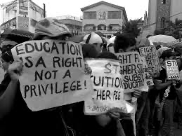
The Global Partners For Education and The UN
A group fighting for people to have a right to education is The Global Partnership For Education. The global partners for education collect donations to fund the advances that countries need to be able to send children to school. They pay teachers and supply countries the tools to be able to have school. The UN enforced that education is not political. Every human has a right to education regardless of sex, sexuality, religion, or race

Slide 6
CITATION
“Civil Rights in Education: Law and History.” Findlaw, 11 Sept. 2017, civilrights.findlaw.com/civil-rights-overview/civil-rights-in-education-law-and-history.html.
“Kalita's Story: Girls' Education Is Key to a Brighter Future.” UNICEF USA, 8 Mar. 2016, www.unicefusa.org/stories/kalitas-story-girls-education-key-brighter-future/30059.
“The Education Deficit.” Human Rights Watch, 12 July 2017, www.hrw.org/report/2016/06/09/education-deficit/failures-protect-and-fulfill-right-education-through-global#.
“United Nations Instruments.” Right to Education Initiative, www.right-to-education.org/page/united-nations-instruments.
Watson, Krista. “9 Stats That Show Why Access To Education Is So Important.” Global Citizen, 26 July 2016, www.globalcitizen.org/en/content/9-facts-about-education/.

Slide 7
VIDEO LINK
https://www.youtube.com/watch?v=9Y7iO28HWiM&rel=0

